Slide 1
CS 201: Data Structures II Unit 02 – Week 1: Array Based Lists
Habib University – Shaping Futures
Faisal Alvi
(For any suggested modifications please email: faisal.alvi@sse.habib.edu.pk)

Slide 2
Unit Outline
Introduction ArrayStack ArrayQueue Summary
Introduction
ArrayStack
ArrayQueue
Summary

Slide 3
Introduction
Introduction ArrayStack ArrayQueue Summary
We begin our coverage of data structures with array based implementations of abstract data types that were covered in the last unit.
Our coverage includes:
ArrayStack – array based stack
ArrayQueue – array based queue
ArrayDeque – array based deque
DualArrayDeque – deque based on dual arrays (time permitting)

Slide 4
Observations
Introduction ArrayStack ArrayQueue Summary
Some important points to take into consideration while using Array based data structures:
Arrays offer constant time access to any value in the array. This can offer constant time access to get and set items within the array.
Arrays are not dynamic. Adding or removing an element near the middle of a list means that a large number of elements in the array need to be shifted.
Arrays cannot expand or shrink. When the number of elements in the data structure exceeds the size of the backing array, a new array needs to be allocated.

Slide 5
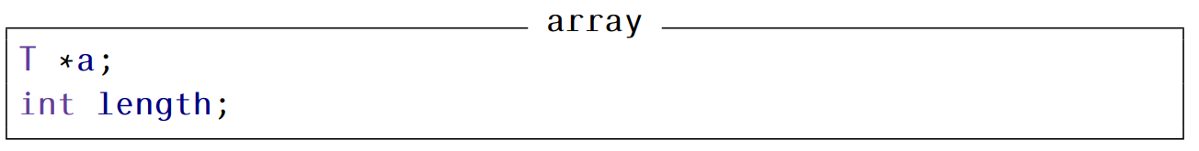
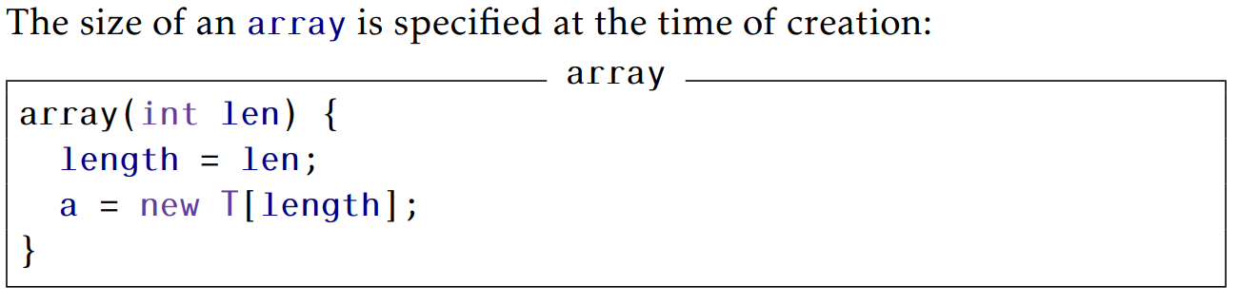
Utility Class: array
Introduction ArrayStack ArrayQueue Summary
In order to keep track of the size of an array, we have defined a class, array, that keeps track of its length.

Slide 6
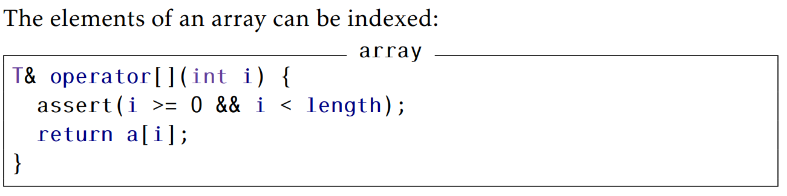
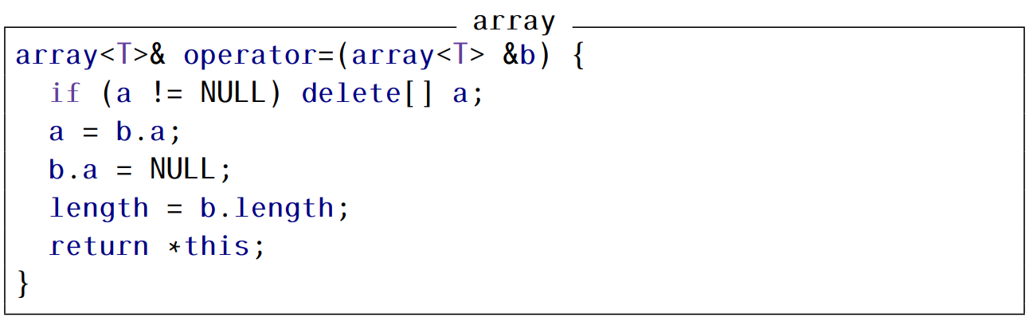
Introduction ArrayStack ArrayQueue Summary

Slide 7
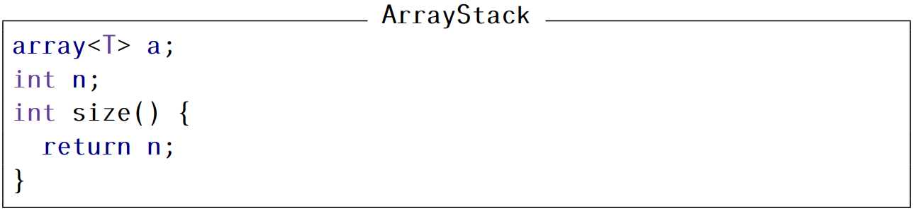
ArrayStack
Introduction ArrayStack ArrayQueue Summary
An ArrayStack implements the list interface using an array a, called the backing array.
The list element with index i is stored in a[ i ].
An integer n is used to keep track of the number of elements actually stored in a.
The list elements are stored in a[0], . . . , a[n − 1] and, at all times, a.length ≥ n.

Slide 8
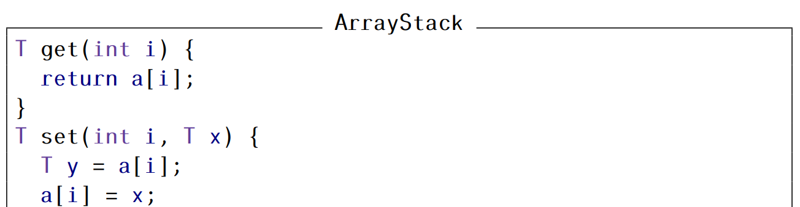
ArrayStack: get and set functions
Introduction ArrayStack ArrayQueue Summary
Accessing and modifying the elements of an ArrayStack using get(i) and set(i, x) is straightforward. After performing any necessary bounds-checking we simply return or set, respectively, a[i].

Slide 9
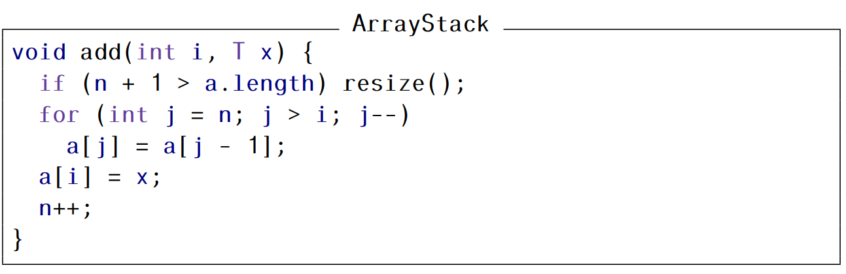
ArrayStack: Adding an element at index i
Introduction ArrayStack ArrayQueue Summary
To implement the add(i, x) operation, we first check if a is already full. If so, we call the method resize() to increase the size of a.
After a call to resize(), we can be sure that a.length > n.
We now shift the elements a[i], …, a[n − 1] right by one position to make room for x, set a[i] equal to x, and increment n.

Slide 10
ArrayStack: Cost of the add operation
Introduction ArrayStack ArrayQueue Summary
If we ignore the cost of the potential call to resize(), then the cost of the add(i, x) operation is proportional to the number of elements we have to shift to make room for x.
Therefore the cost of this operation (ignoring the cost of resizing a) is O(n − i).

Slide 11
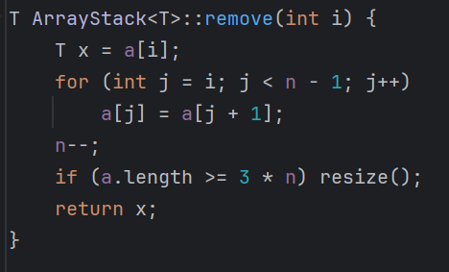
ArrayStack: Removing an element at index i
Introduction ArrayStack ArrayQueue Summary
Implementing the remove(i) operation is similar.
We shift the elements a[i + 1], … , a[n − 1] left by one position (overwriting a[i]) and decrease the value of n.
After doing this, we check if n is getting much smaller than a.length by checking if a.length ≥ 3n.
If so, then we call resize() to reduce the size of a.

Slide 12
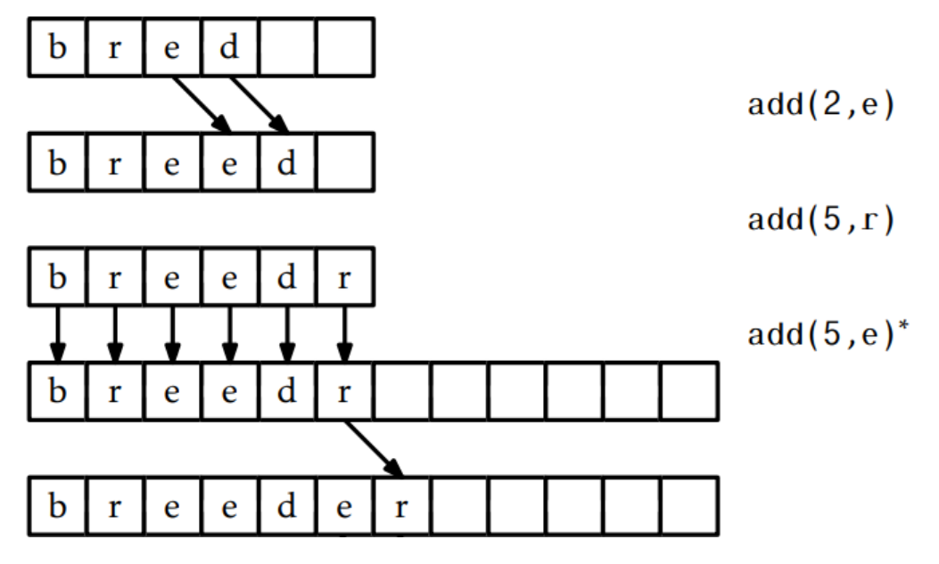
ArrayStack: Examples of add and remove
Introduction ArrayStack ArrayQueue Summary

Slide 13
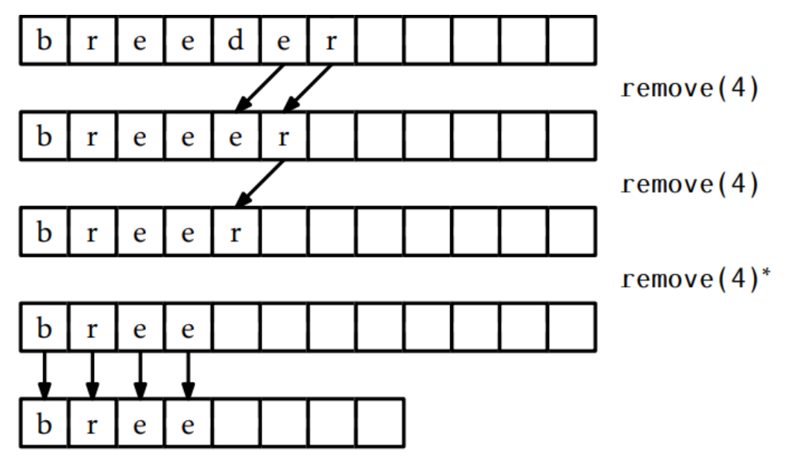
ArrayStack: Examples of add and remove
Introduction ArrayStack ArrayQueue Summary

Slide 14
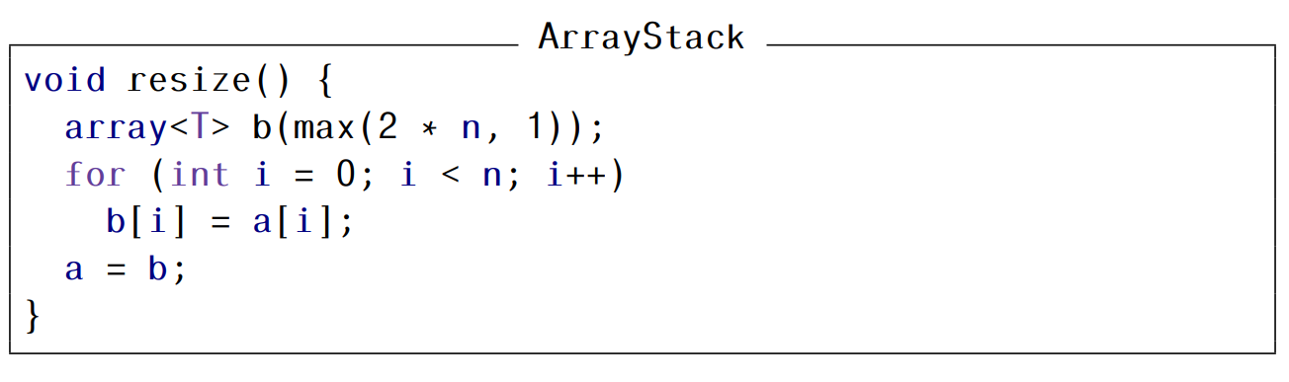
ArrayStack: The resize method
Introduction ArrayStack ArrayQueue Summary
The resize() method allocates a new array b whose size is 2n.
It copies the n elements of a into the first n positions in b, and then sets a to b. Thus, after a call to resize(), a.length = 2n.
The resize() operation allocates an array b of size 2n and copies the n elements of a into b. This takes O(n) time

Slide 15
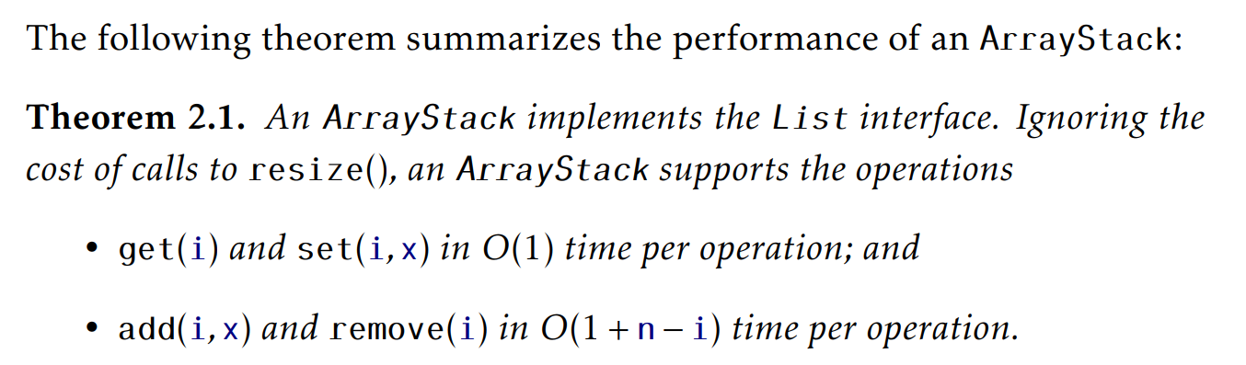
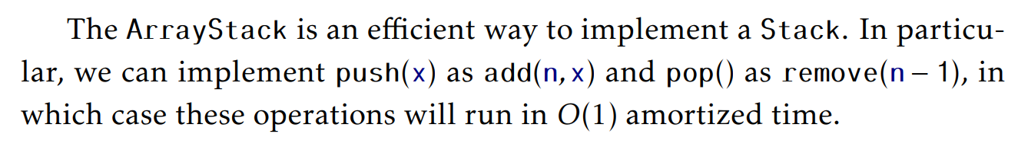
ArrayStack: Summary
Introduction ArrayStack ArrayQueue Summary

Slide 16
ArrayQueue
Introduction ArrayStack ArrayQueue Summary
Next we present the ArrayQueue Data Structure.
Notice that an ArrayStack is a poor choice for an implementation of a FIFO queue.
It is not a good choice because we must choose one end of the list upon which to add elements and then remove elements from the other end.

Slide 17
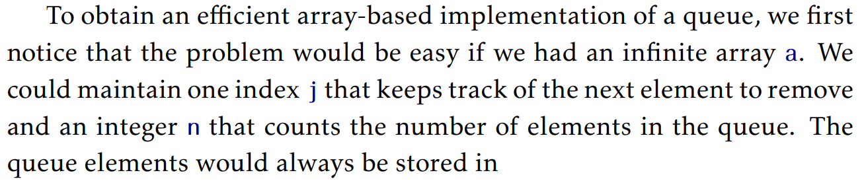

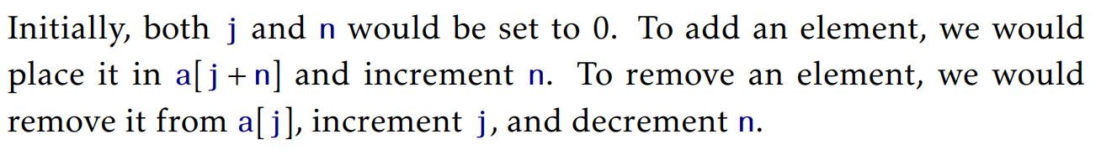
ArrayQueue
Introduction ArrayStack ArrayQueue Summary

Slide 18
Modular Arithmetic
Introduction ArrayStack ArrayQueue Summary
An ArrayQueue simulates this by using a finite array a and modular arithmetic.
For example 10:00 plus five hours gives 3:00.
Formally, we say that 10 + 5 = 15 ≡ 3 (mod 12) .
We read the latter part of this equation as “15 is congruent to 3 modulo 12.”
We can also treat mod as a binary operator, so that 15 mod 12 = 3 .

Slide 19
ArrayQueue
Introduction ArrayStack ArrayQueue Summary
Using modular arithmetic we can store the queue elements at array locations:
a [ j % a.length], a[(j + 1) % a.length], …, a[(j + n − 1) % a.length].
This treats the array a like a circular array in which array indices larger than a.length − 1 “wrap around” to the beginning of the array.

Slide 20
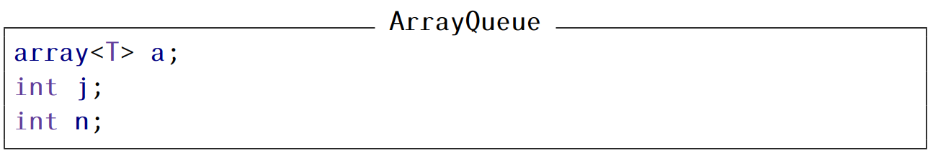
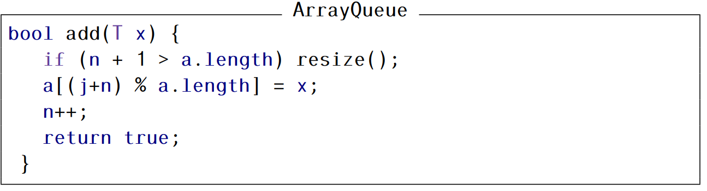
ArrayQueue: Implementation
Introduction ArrayStack ArrayQueue Summary

Slide 21
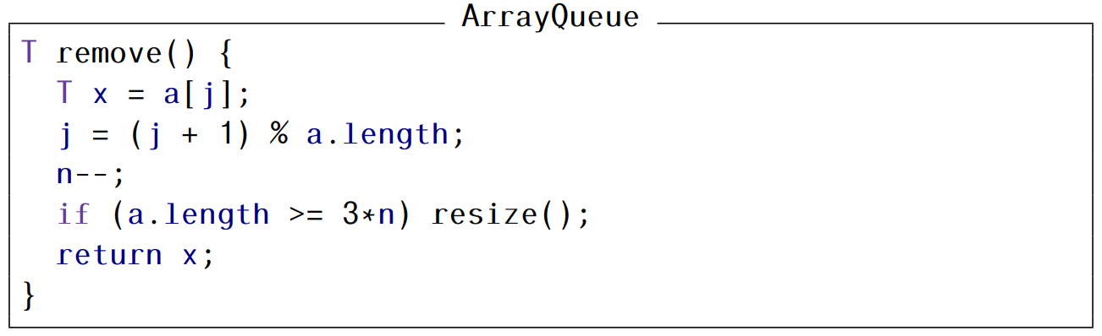
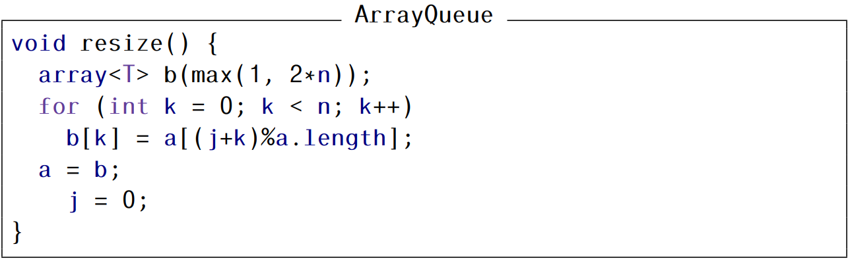
ArrayQueue: Implementation
Introduction ArrayStack ArrayQueue Summary

Slide 22
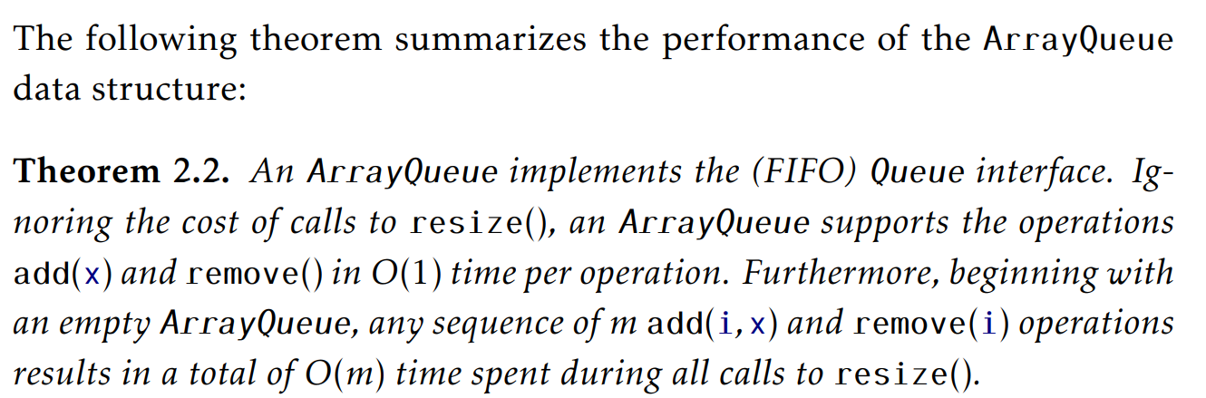
ArrayQueue: Summary
Introduction ArrayStack ArrayQueue Summary

